Slide 1
What is Angular?
Various Steps Involved in Angular CLI
Various Features Of Angular
Advantages and Disadvantages Of Angular

Slide 2
What is Angular?
Angular is an open-source, JavaScript framework written in TypeScript. Google maintains it, and its primary purpose is to develop single-page applications. As a framework, Angular has clear advantages while also providing a standard structure for developers to work with. It enables users to create large applications in a maintainable manner.

Slide 3
Why Do You Need a Framework?
Frameworks in general boost web development efficiency and performance by providing a consistent structure so that developers don’t have to keep rebuilding code from scratch. Frameworks are time savers that offer developers a host of extra features that can be added to software without requiring extra effort.

Slide 4
What is Single Page Application (SPA)?
A single page application is a web application or a website which provides users a very fluid, reactive and fast experience similar to a desktop application. It contains menu, buttons and blocks on a single page and when a user clicks on any of them; it dynamically rewrites the current page rather than loading entire new pages from a server. That's the reason behind its reactive fast speed.

Slide 5
Various Steps Involved in Angular CLI
Prerequisites-
Before we begin, make sure you have Node.js installed on your machine. You can download and install it from the official Node.js website (https://nodejs.org). Angular utilizes Node.js and npm (Node Package Manager) to manage dependencies and the development environment.

Slide 6
Step 1: Install Angular CLI
Angular CLI (Command Line Interface) is a command-line tool that makes it easy to create and manage Angular projects. Open your terminal and run the following command to install Angular CLI globally:
npm install -g @angular/cli

Slide 7
Step 1: Install Angular CLI
Once the installation is complete, verify that Angular CLI has been installed successfully by running the following command:
ng version

Slide 8
Step 2: Create a New Project
Now that you have Angular CLI installed, you can create a new Angular project. Run the following command in your terminal:
ng new my-angular-project
This will create a new directory named “my-angular-project” and generate the initial project structure.

Slide 9
Step 3: Navigate to the Project Directory
Enter the newly created project directory by using the following command:
cd my-angular-project

Slide 10
Step 4: Start the Development Server
Once you’re inside the project directory, run the following command to start the Angular development server:
ng serve
This will compile your project and run it on a local server. Open your web browser and navigate to http://localhost:4200. You should see your Angular application up and running.

Slide 11
Step 5: Create a Component
Components are the fundamental building blocks in Angular. You can create a component using the following command:
ng generate component component-name
This will automatically generate the necessary files for your new component, including the TypeScript file, HTML template, and CSS styling file.

Slide 12
Step 6: Configure Routes
Routes allow you to navigate between different components in your application. To configure routes, open the app-routing.module.ts file and add the following code:
import { NgModule } from '@angular/core';
import { Routes, RouterModule } from '@angular/router';
import { HomeComponent } from './home/home.component';
import { AboutComponent } from './about/about.component';

Slide 13
Step 6: Configure Routes
const routes: Routes = [
{ path: '', component: HomeComponent },
{ path: 'about', component: AboutComponent },
];
@NgModule({
imports: [RouterModule.forRoot(routes)],
exports: [RouterModule]
})
export class AppRoutingModule { }

Slide 14
Step 6: Configure Routes
This will configure routes for two components: “HomeComponent” and “AboutComponent”. Make sure to create these components and their corresponding templates accordingly.

Slide 15
Step 7: Add Content to Components
Now you can add content to your newly created components. Open the component files (component-name.component.ts, component-name.component.html, and component-name.component.css) and customize them as per your needs. You can add text, images, links, and more.

Slide 16
Step 8: Run the Application
Once you have finished adding content to your components, save the files and go back to your terminal. Make sure the Angular development server is still running. If not, run the following command again:
ng serve
Then, open your browser and visit http://localhost:4200. You should see your Angular application with the components and routes you have created.

Slide 17
Features of Angular
Document Object Model
TypeScript
Data Binding
Testing
Productivity
Full Stack Development
Angular supports multiple platforms
High Speed, Ultimate Performance

Slide 18
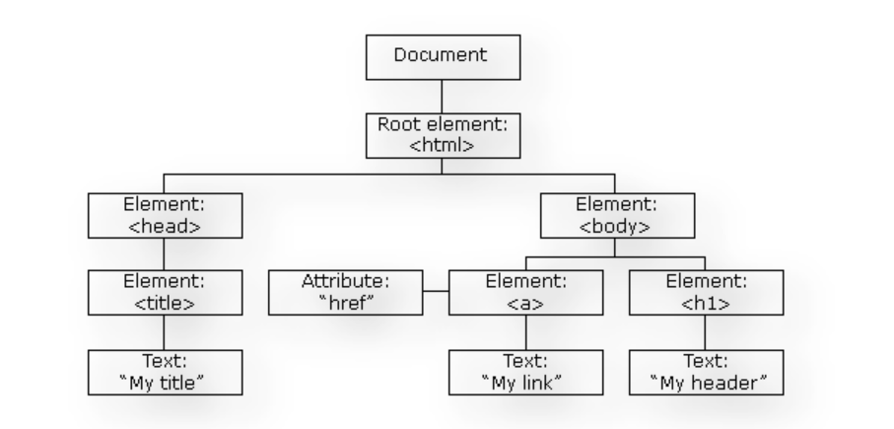
1. Document Object Model
DOM (Document Object Model) treats an XML or HTML document as a tree structure in which each node represents a part of the document.

Slide 19
1. Document Object Model
Angular uses regular DOM. Consider that ten updates are made on the same HTML page. Instead of updating the ones that were already updated, Angular will update the entire tree structure of HTML tags.

Slide 20
2. TypeScript
TypeScript defines a set of types to JavaScript, which helps users write JavaScript code that is easier to understand. All of the TypeScript code compiles with JavaScript and can run smoothly on any platform. TypeScript is not compulsory for developing an Angular application. However, it is highly recommended as it offers better syntactic structure—while making the codebase easier to understand and maintain.

Slide 21
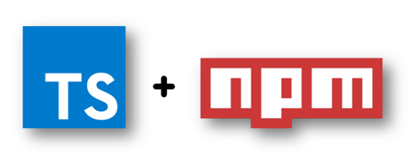
2. TypeScript
You can install TypeScript as an NPM package with the following command:
npm install -g typescript

Slide 22
3. Data Binding
Data binding is a process that enables users to manipulate web page elements through a web browser. It employs dynamic HTML and does not require complex scripting or programming. Data binding is used in web pages that include interactive components, such as calculators, tutorials, forums, and games. It also enables a better incremental display of a web page when pages contain a large amount of data.

Slide 23
3. Data Binding
Angular uses the two-way binding. The model state reflects any changes made in the corresponding UI elements. Conversely, the UI state reflects any changes in the model state. This feature enables the framework to connect the DOM to the model data through the controller.

Slide 24

4. Testing
Angular uses the Jasmine testing framework. The Jasmine framework provides multiple functionalities to write different kinds of test cases. Karma is the task-runner for the tests that uses a configuration file to set the start-up, reporters, and testing framework.

Slide 25
5. Productivity
Angular provides a better productivity due to its simple and powerful template syntax, command line tools and popular editors and IDEs.
1. Powerful templates: Angular provides simple and powerful template syntax to create UI view quickly.
2. IDEs: Angular provides intelligent code completion, instant errors, and other feedback in popular editors and IDEs.
3. Angular CLI: Angular CLI provides command line tools start building fast, add components and tests, and then instantly deploy.

Slide 26
6. Full Stack Development
Angular is a complete framework of JavaScript. It provides Testing, animation and Accessibility. It provides full stack development along with Node.js, Express.js, and MongoDB.
1. Testing: Angular provides Karma and Jasmine for unit testing. B y using it, you can check your broken things every time you save. Karma is a JavaScript test runner tool created by Angular team. Jasmine is the testing framework form unit testing in Angular apps, and Karma provides helpful tools that make it easier to us to call our Jasmine tests whilst we are writing code.
2. Animation Support: Angular facilitates you to create high-performance, complex choreographies and animation timelines with very little code through Angular's intuitive API.
3. Accessibility: In Angular, you can create accessible applications with ARIA-enabled components, developer guides, and built-in a11y test infrastructure.

Slide 27
7. Angular supports multiple platforms
Angular is a cross platform language. It supports multiple platforms. You can build different types of apps by using Angular.
1. Desktop applications: Angular facilitates you to create desktop installed apps on different types of operating systems i.e. Windows, Mac or Linux by using the same Angular methods which we use for creating web and native apps.
2. Native applications: You can built native apps by using Angular with strategies from Cordova, Ionic, or NativeScript.
3. Progressive web applications: Progressive web applications are the most common apps which are built with Angular. Angular provides modern web platform capabilities to deliver high performance, offline, and zero-step installation apps.

Slide 28
8. High Speed, Ultimate Performance
Angular is amazingly fast and provides a great performance due to the following reasons:
1. Universal support: Angular can be used as a front-end web development tool for the programming languages like Node.js, .Net, PHP, Java Struts and Spring and other servers for near-instant rendering in just HTML and CSS. It also optimizes the website for better SEO.
2. Code splitting: Angular apps are fast and loads quickly with the new Component Router, which delivers automatic code-splitting so users only load code required to render the view they request.
3. Code generation: Angular makes your templates in highly optimized code for today?s JavaScript virtual machines which gives the benefits of hand-written code.

Slide 29
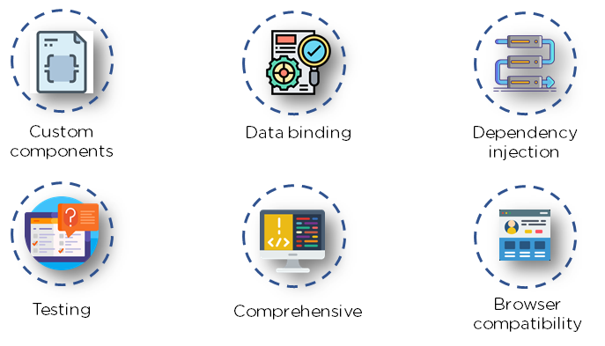
Advantages of Angular

Slide 30
1. Custom Components
Angular enables users to build their own components that can pack functionality along with rendering logic into reusable pieces. It also plays well with web components.

Slide 31
2. Data Binding
Angular enables users to effortlessly move data from JavaScript code to the view, and react to user events without having to write any code manually.

Slide 32
3. Dependency Injection
Angular enables users to write modular services and inject them wherever they are needed. This improves the testability and reusability of the same services.

Slide 33
4. Testing
Tests are first-class tools, and Angular has been built from the ground up with testability in mind. You will have the ability to test every part of your application—which is highly recommended.

Slide 34
5. Comprehensive
Angular is a full-fledged framework and provides out-of-the-box solutions for server communication, routing within your application, and more.

Slide 35
6. Browser Compatibility
Angular is cross-platform and compatible with multiple browsers. An Angular application can typically run on all browsers (Eg: Chrome, Firefox) and OSes, such as Windows, macOS, and Linux.

Slide 36
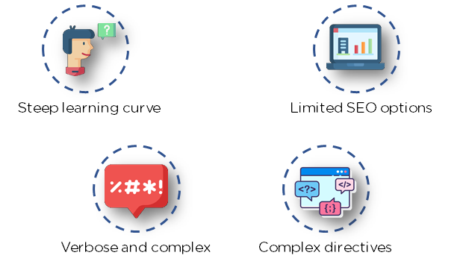
Disadvantages of Angular

Slide 37
1. Steep Learning Curve
The basic components of Angular that all users should know include directives, modules, decorators, components, services, dependency injection, pipes, and templates. More advanced topics include change detection, zones, AoT compilation, and Rx.js. For beginners, Angular 4 may be challenging to learn because it is a complete framework.

Slide 38
2. Limited SEO Options
Angular offers limited SEO options and poor accessibility to search engine crawlers.

Slide 39
3. Migration
One of the reasons why companies do not frequently use Angular is the difficulty in porting legacy js/jquery-based code to angular style architecture. Also, each new release can be troublesome to upgrade, and several of them are not backward-compatible.

Slide 40
4. Verbose and Complex
A common issue in the Angular community is the verbosity of the framework. It is also fairly complex compared to other front-end tools.

